Slide 1
Introduction to Social Network Analysis
Prof. Tom Kwanya

Slide 2
Definitions
Social network analysis (SNA) is the process of investigating social structures through the use of networks (Otte and Rousseau, 2002).
The mapping and measuring of relationships and flows between people, groups, organizations, computers, URLs, and other connected information/knowledge entities. The nodes in the network are the people and groups.

Slide 3
Key Concepts…Ctd
Sociogram – This is a visualization of a social network with defined boundaries of connections in the network.
Size – A measure of the number of actors (nodes) in a complete or egocentric network.
Distance – The number of “steps” between any two actors in a network.
Node – Entities in a social network.

Slide 4
Key Concepts
Density - The number of connections a participant has, divided by the total possible connections a participant could have.
Centrality - Measures the extent to which an individual interacts with other individuals in the network. The more an individual connects to others in a network, the greater their centrality in the network.

Slide 5
Types of Social Networks
Egocentric – Focuses on the individual; studies an individual’s personal network and its affects on that individual.
Sociocentric – Focuses on large groups of people; quantifies relationships between people in a group; studies patterns of interactions and how these patterns affect the group as a whole.

Slide 6
Metrics – Connections
Homophily - The extent to which actors form ties with similar versus dissimilar others.
Multiplexity - The number of content-forms contained in a tie. For example, two people who are friends and also work together would have a multiplexity of 2.
Mutuality/Reciprocity - The extent to which two actors reciprocate each other's friendship or other interaction.

Slide 7
Metrics – Distributions
Bridge - An individual whose weak ties fill a structural hole, providing the only link between two individuals or clusters
Centrality - The "importance" or "influence“ of a node in a network.
Density - The proportion of direct ties in a network relative to the total number possible.
Distance - The minimum number of ties required to connect two particular actors.

Slide 8
Metrics – Distributions…Ctd
Structural holes - The absence of ties between two parts of a network.
Tie strength - Defined by the linear combination of time, emotional intensity, intimacy and reciprocity. Strong ties are associated with homophily, propinquity (closeness) and transitivity (cross-relations), while weak ties are associated with bridges.

Slide 9
Metrics – Segmentation
Groups are identified as 'cliques' if every individual is directly tied to every other individual; 'social circles' if there is less direct.
Clustering coefficient - A measure of the likelihood that two associates of a node are associates; a higher clustering coefficient indicates a greater ‘cliquishness’.
Cohesion - The degree to which actors are connected directly to each other

Slide 10
Application
Friendship and acquaintance networks
Collaboration networks
Kinship and relationships
Disease transmission
Customer interaction analysis
Marketing
Business intelligence
Individual and group engagement

Slide 11
Application…Ctd
In Information and knowledge management, social network analysis can be used to study the following:
information needs;
information exposure;
information legitimation;
information routes; and
information opportunities.

Slide 12
Social Network Analysis Tools
AllegroGraph
Automat
Gephi
GraphStream
Graphviz
Mathematica
NodeXL
NetworkX
UNISoN
UCINET
Tulip
Wolfram Alpha
Commetrix
EgoNet

Slide 13
Data Structures
From pictures to matrices
b
d
b
d
a
c
e
a
c
e
Undirected, binary
Directed, binary
a
b
c
d
e
a
b
c
d
e
a
1
a
1
b
1
1
b
1
c
1
1
1
c
1
1
1
d
1
1
d
e
1
1
e
1
1

Slide 14
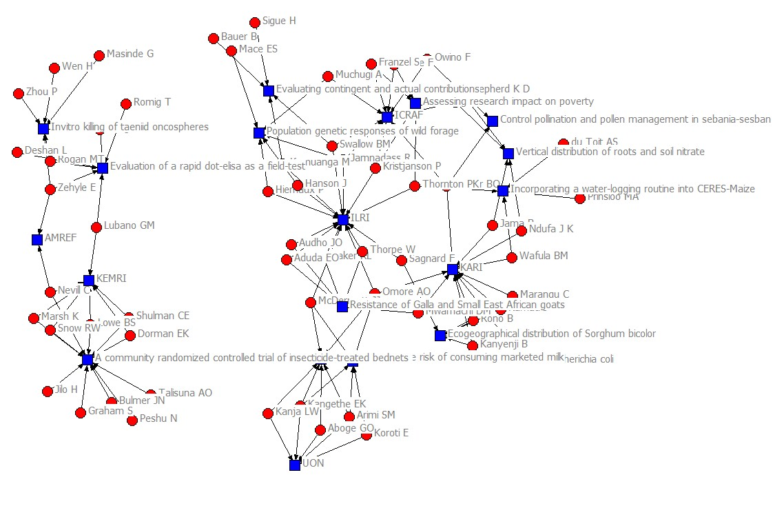
Example of a Sociogram

Slide 15
Significance
“To speak of social life is to speak of the association between people – their associating in work and in play, in love and in war, to trade or to worship, to help or to hinder. It is in the social relations men establish that their interests find expression and their desires become realized.”
Peter M. Blau
Exchange and Power in Social Life, 1964

Slide 16
Significance…Ctd
"If we ever get to the point of charting a whole city or a whole nation, we would have … a picture of a vast solar system of intangible structures, powerfully influencing conduct, as gravitation does in space. Such an invisible structure underlies society and has its influence in determining the conduct of society as a whole."
J.L. Moreno
New York Times, April 13, 1933

Slide 17
Significance…Ctd
“For the last thirty years, empirical social research has been dominated by the sample survey. But as usually practiced, …, the survey is a sociological meat grinder, tearing the individual from his social context and guaranteeing that nobody in the study interacts with anyone else in it.”
Allen Barton, 1968
(Quoted in Freeman 2004)

Slide 18
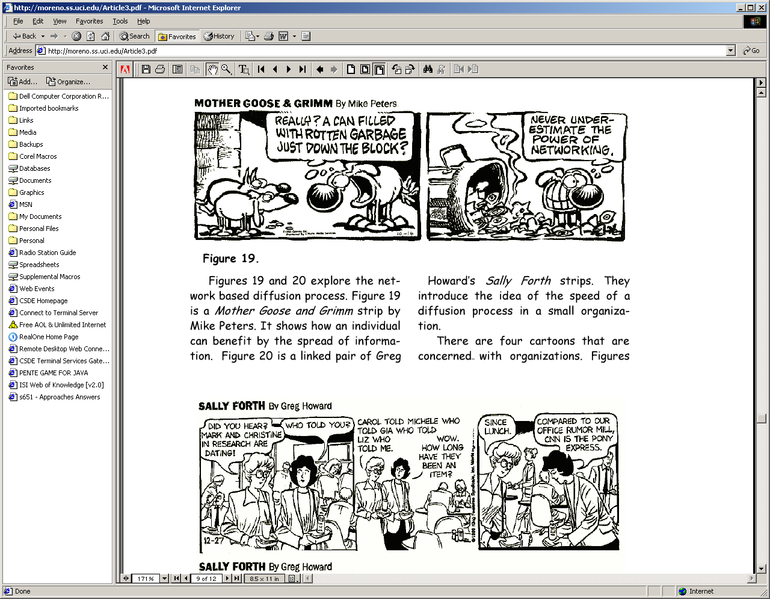
Significance…Ctd

